Slide 1
Capstone Project
Project 1 – Group 1
Notes:
Use white as base

Slide 2
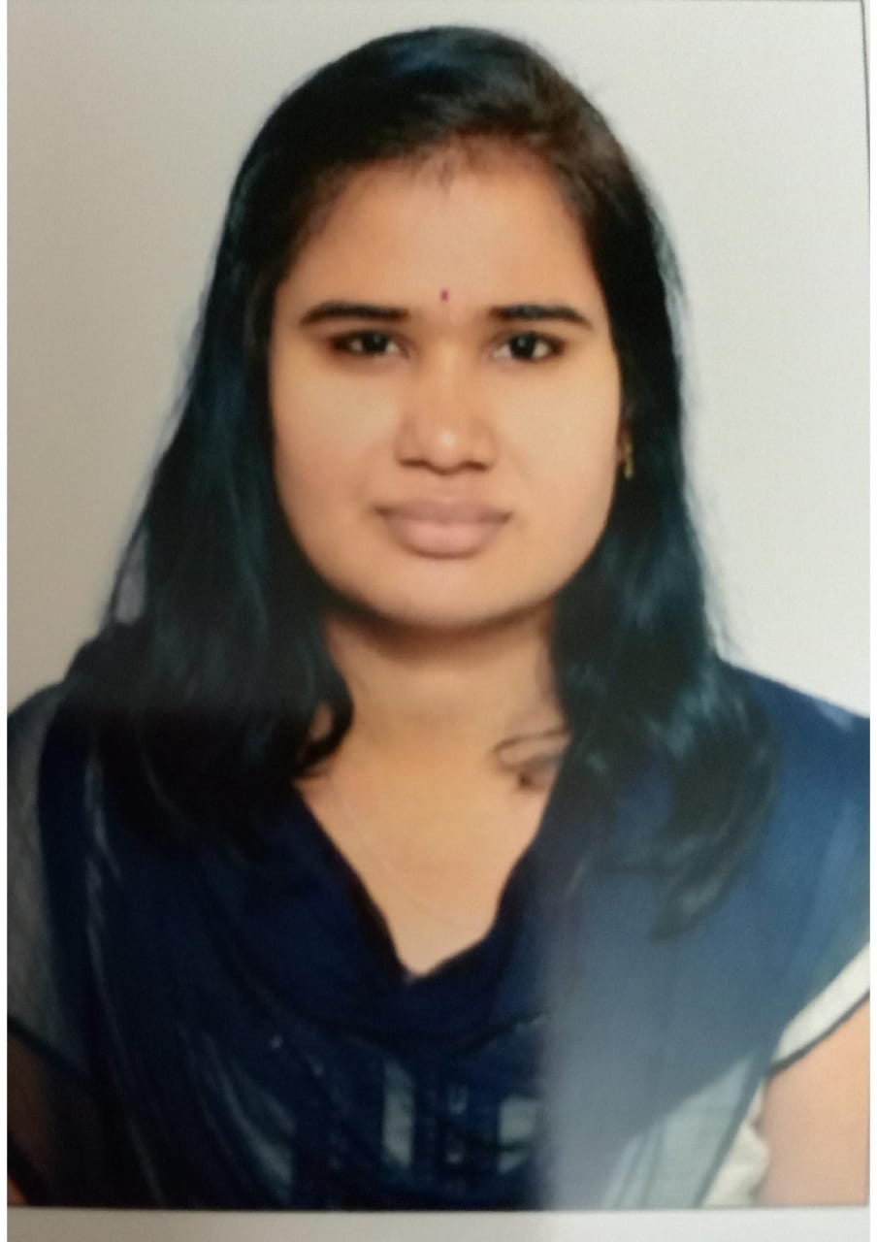



MEMBER OF GROUP
Tuan Anh
Eddala Hymavathi
Sagala Madhuri
Vu Tu

Slide 3


TABLE OF CONTENTS
01
Introduce project name
02
Work assignment and work schedule
03
Results achieved and demo product
Notes:
The best. Change to greys

Slide 4
INTRODUCE PROJECT NAME
01
Project Name -ShopForHome
Problem Statement: ShopForHome is a popular Store in the market for shopping the home décor stuff .Due to Covid 19 all the offline shopping stopped. So the store wants to move to the online platforms and wants their own web application. There are 2 users on the application:
1.User
2.Admin

Slide 5
WORK ASSIGNMENT AND WORK SCHEDULE
02
Work assignment:
Database
- Vu Tu
Fontend
- Admin: Sagala Madhuri
- User : Eddala Hymavathi
Microservice
- Tuan Anh
Backend
- Tuan Anh
- Vu Tu

Slide 6
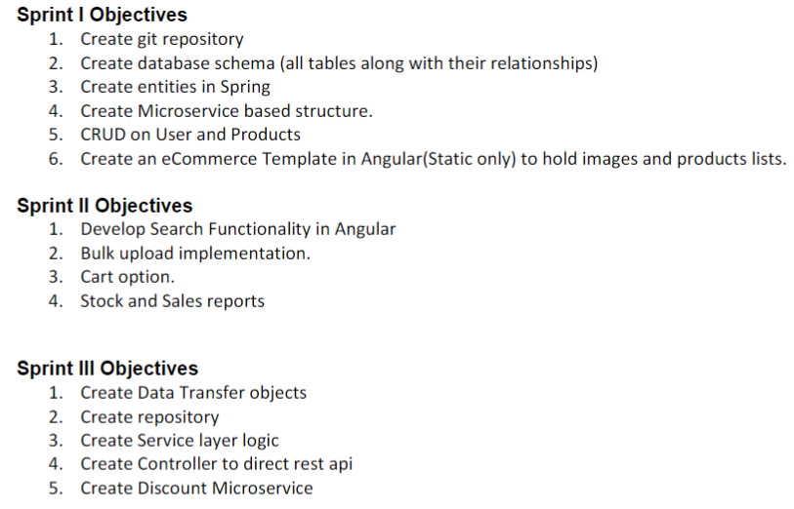
02
WORK ASSIGNMENT AND WORK SCHEDULE
Work schedule:

Slide 7

03
RESULTS ACHIEVED AND DEMO PRODUCT
Results achieved
Demo product

Slide 8

THANKS FOR YOUR ATTENTION
Any questions for us ?

